Slide 1


Slide 2
Introduction to Data Analyst and Data Science for Beginners Lecture # 2 Variables and Data types in Python
Ehtisham Sadiq

Slide 3
Today’s Agenda
Recap of Previous Lecture
print() Function / Built-in function
Variables in Python
Variables Names
What is variable
Declaring Variables and Assigning Values
Object References
Object Identity
Multiple Assignments
Python Variables Types
Delete a variable
Maximum possible value of integer in python
Print single and multiple variables in python
Python Data Types
Immutable
Mutable
Input(), int(), float() functions

Slide 4

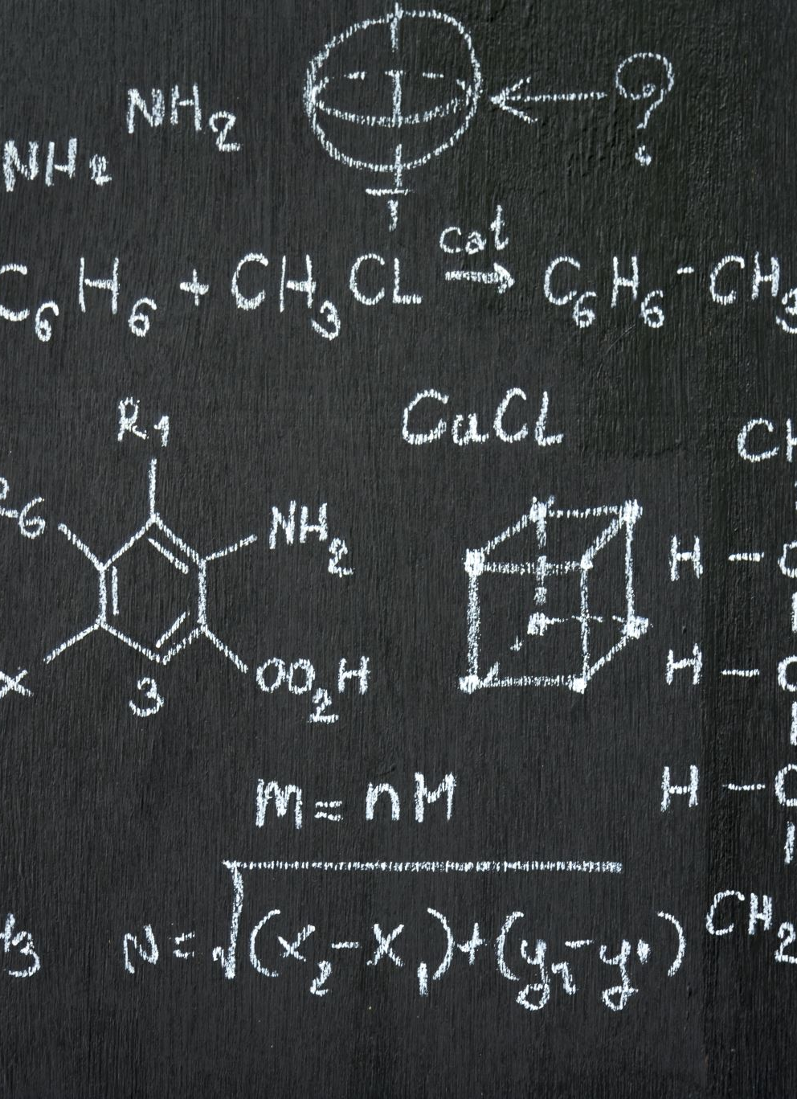
print() Function
Python print() function prints the given object on the screen or other standard output devices.
Syntax :
print(object(s) , sep= separator, end=end)
object(s): It is an object to be printed. The Symbol * indicates that there may be more than one object.
sep='separator' (optional): The objects are separated by sep. The default value of sep is “ ”.
end = 'end' (optional): it determines which object should be print at last.

Slide 5
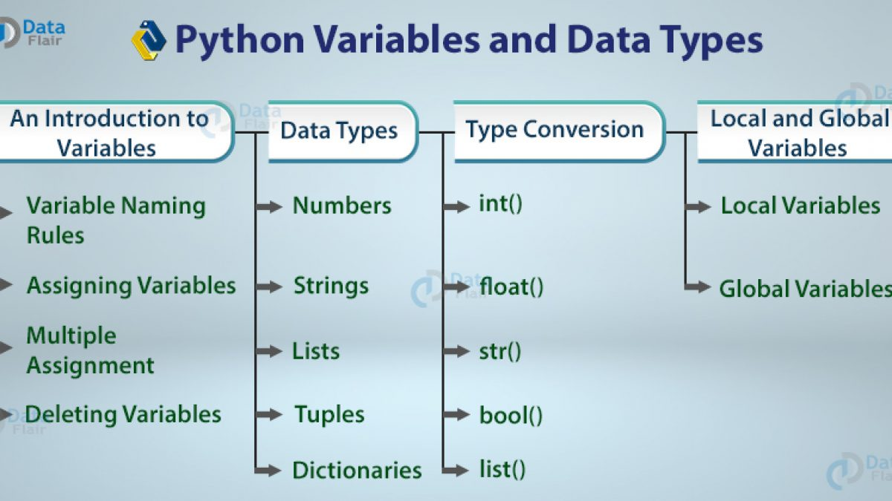
Variables In Python

Slide 6

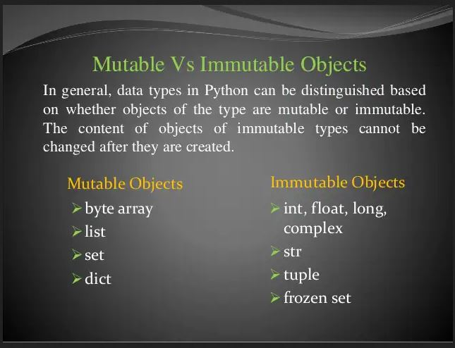



Mutable and Immutable Objects in Python

Slide 7
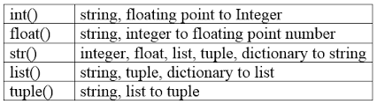
Int(), float(), str()

Slide 8

Any Question

